Slide 1
RISC-V Security Nov 2021

Slide 2
Intrinsic Security
Zero Trust Model
Root of Trust and Secure Boot
Standards and Certification
Security Ecosystem
Confidential Computing
Isolation
Attestation
Secure Storage
Life Cycle Management
Identity
Security as a basic feature of HW, SW Firmware
Support security through entire lifecycle
Guidelines matched to profiles

Slide 3
Scope
Security Model
Security Ecosystem
Memory Safety
Microarchitectural side channels
Robustness
Cryptography
Isolation & TEEs
Confidential Compute
Blockchains
Security Issues & Response (SIRT)

Slide 4
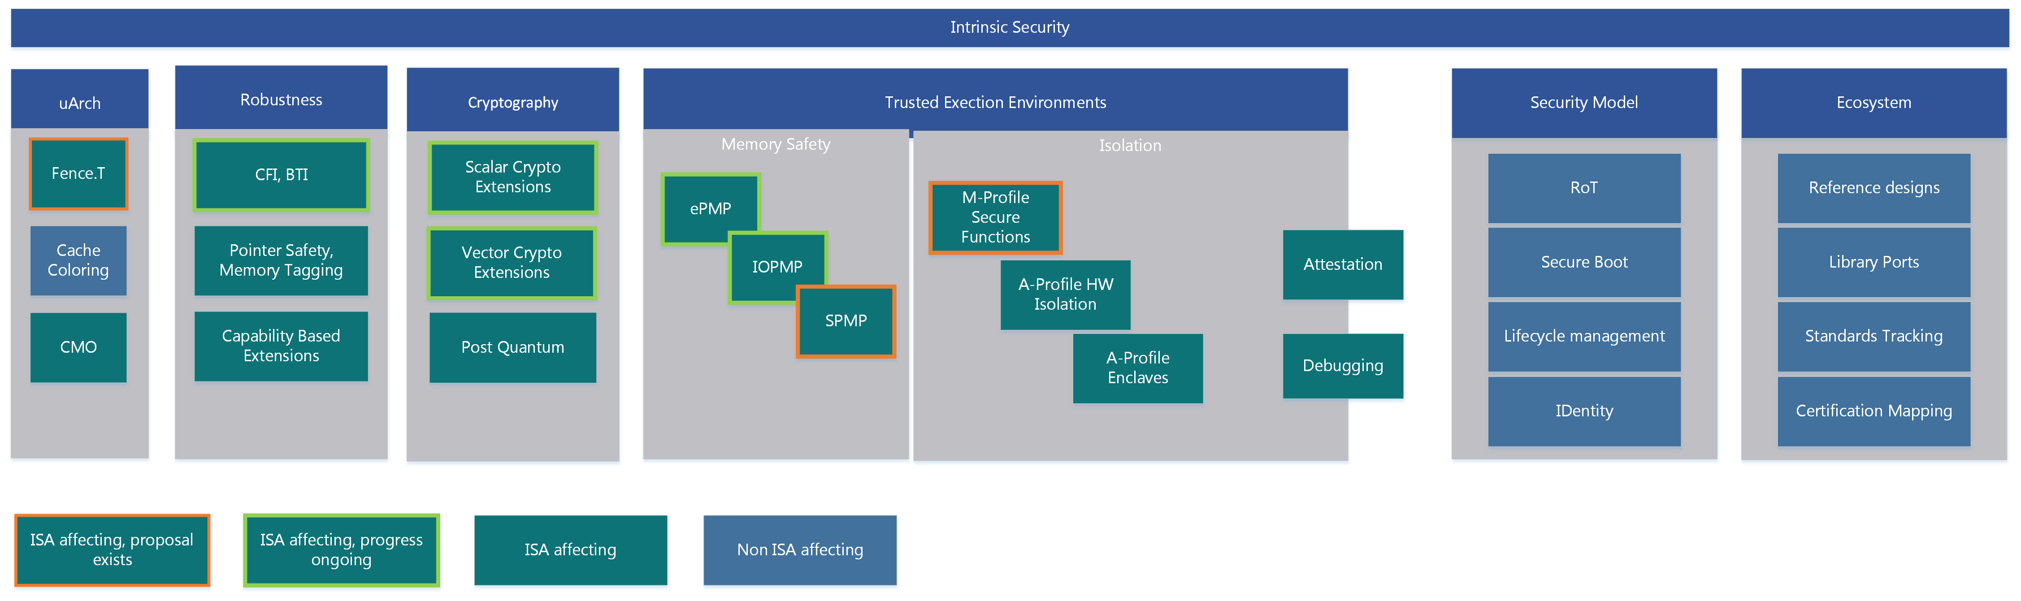

Slide 5
Security Model
State Goals & Rationale for RISC-V Security
Defines scope
Derives security requirements
Abstracted from implementation specifics
References existing standards when appropriate
Referenced by appropriate sections of Platform specifications
By Profile, By Vertical

Slide 6
Security Model
Guiding Principle
Intrinsic security
Zero-Trust
Outline:
Scope, Goals, and Guiding Principles
Security Concerns
Threat Model
Security Topics
Topics:
Lifecycle
Platform Integrity
Data Integrity
Isolation
Secure Boot
Assurance & Attestation
Secure storage
Cryptography
Applicable Standards

Slide 7
Security Ecosystem
Enablement of RISC-V security services & software
Identify and list key open-source security software and libraries
Develop RISC-V security reference implementation(s)
Identify, monitor, and influence applicable standards
Identify and liaison with applicable Security Certification entities

Slide 8
Security Ecosystem
Security Services
Reference implementations
Secure Boot
Attestation
…
Optimised library ports
OpenSSL
mbed Crypto
OS ports
APIs, Calling Conventions
Standards and Certification
Formal Security Proofs
Certification mapping
Verticals
Any Specific requirements ?

Slide 9
Memory Safety
Define strategy for memory protection at the ISA level
Identify improvements that enhance memory security in RISC-V systems
Develop and maintain specifications / ISA extensions for memory safety

Slide 10
uArchitectural Side Channels
Understand how the microarchitecture is vulnerable to information leakage
Identify potential side-channel and covert-channel information leakage
Develop strategy to prevent microarchitectural information leakage in RISC-V systems
Develop and maintain specification/recommendations that mitigate microarchitectural side channels

Slide 11
Side Channel Leakage Protection
ISA extensions to control uArch ?
Fence.t

Slide 12
Robustness
Understand how malicious actors manipulate and exploit (unexpected) system behavior
Identify capabilities that improve system level robustness under adversarial conditions
Define strategy that will improve robustness of RISC-V systems at ISA or non-ISA level
Develop, maintain, or support creation of specifications as needed

Slide 13
Robustness
Control Flow Integrity
BTI, PAC etc
Side Channel Leakage Protection
ISA extensions to control uArch ?
Fence.t
Capability Based
CHERI JWG
Alternatives ?

Slide 14
Cryptography
Understand the landscape of cryptographic schemes and threats against established cryptography
Identify what cryptographic primitives, constructs, and algorithms are in-scope for RISC-V
Develop and maintain crypto related specifications

Slide 15
Isolation & TEEs
Identify what technologies enable isolation and Trusted Execution Environments (TEEs)
Define how isolation/TEEs can be implemented on RISC-V systems
Create gap analysis to identify missing components
Develop, maintain, or support creation of specifications for Isolation/TEEs

Slide 16
Trusted Execution
Memory Safety
PMP based TEEs
Hardware based Isolation
M-Class secure functions
A-Class Maintaining privilege levels in TEE
Attestation of entire software chain from initial boot
Security aware Debugging
Maybe ISA affecting / ISA Affecting

Slide 17
Confidential Compute
Survey technologies or technology stacks used in Confidential Compute
Define requirements that enable Confidential Compute on RISC-V systems
Create technology gap analysis for RISC-V
Develop, maintain, or support creation of specifications as needed

Slide 18
Trusted Execution
Confidential Compute
Mutually untrusted applications
Isolated Application Enclaves
Encrypted Enclaves
Maybe ISA affecting / ISA Affecting

Slide 19
Blockchains
Define requirements for enabling blockchains/distributed ledgers on RISC-V systems
Identify and address RISC-V technology gaps in enabling distributed ledger technologies
Create use cases and developer guidelines for deploying blockchains/distributed ledgers on RISC-V systems

Slide 20
SIRT
Ensure continuity of the RISC-V Security Incident Response Team (SIRT)
Institute and manage a responsible disclosure process
Triage incoming security disclosures
Maintain a catalogue of security issues

Slide 21
Security Organization

Slide 22
Status Nov 2021

Slide 23
Current Status – RISC-V Security HC
Started Security Model team under HC to create high level recommendations for RoT, secure boot, attestation, temporal isolation, updateability, identity, and the rationale.
Refocused & renamed the Security Tech SIG
Suresh remains chair
Trusted Execution and Confidential Computing
Initial work is to define the requirements, aim to charter TG(s)
CFI SIG set up, call for chairs candidates closes on Nov 9, 2021
uArchitectural Side Channel SIG charter approved
To-do:
Create Joint Working Group (JWG) for CHERI discussion
Move most of the Current TEE TG work to a new SIG ‘Memory Safety SIG’ -
Meetings structure unchanged, chair remains Nick
Create individual TGs for each task with specific charter
Still need focus on Security SW and Ecosystem – any volunteers ?

